Slide 1
Oothat Baithat Sovat Naam

Slide 2
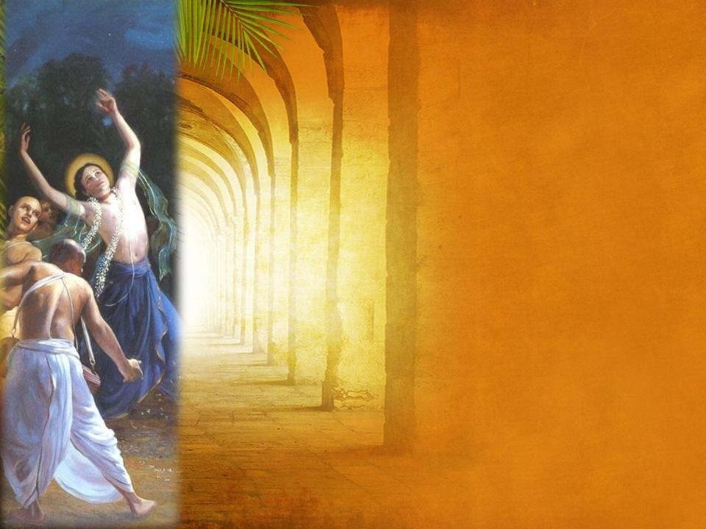
Oothat Baithat Sovat Naam
Aur Na Ko-ee Ko-ee Kaam
Naachat, Gaavat, Teraa Naam, Naachat, Gaavat, Teraa Naam
Ram Lakhan Radhey Shyam, Ram Lakhan Radhey Shyam

Slide 3
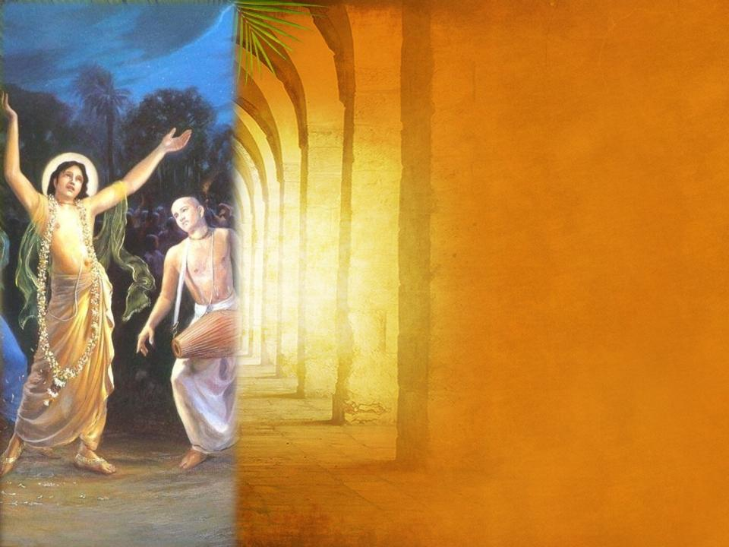
Meher Milyaa Gur Murshid Pooraa,
Moray Man Bhayaa Vishraam, Naachat Gaavat Tera Naam
Oothat Baithat Sovat Naam, Aur Na Ko-ee Ko-ee Kaam
Ram Lakhan Radhey Shyam, Ram Lakhan Radhey Shyam

Slide 4
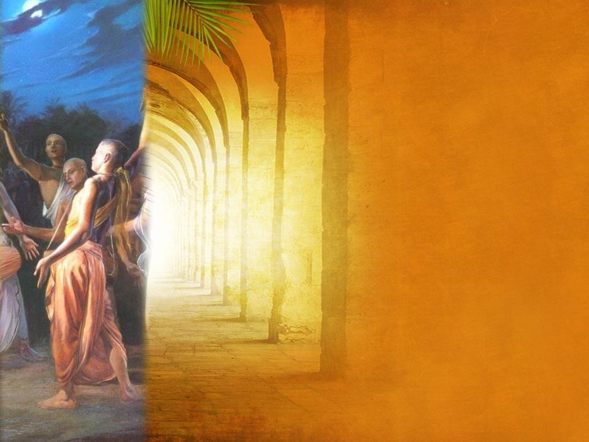
Gurdev Pyaaray Rahim Neehaaray
Roshan Roshan Roohaanee Dhaam, Naachat Gaavat Tera Naam
Oothat Baithat Sovat Naam, Aur Na Ko-ee Ko-ee Kaam
Ram Lakhan Radhey Shyam, Ram Lakhan Radhey Shyam

Slide 5
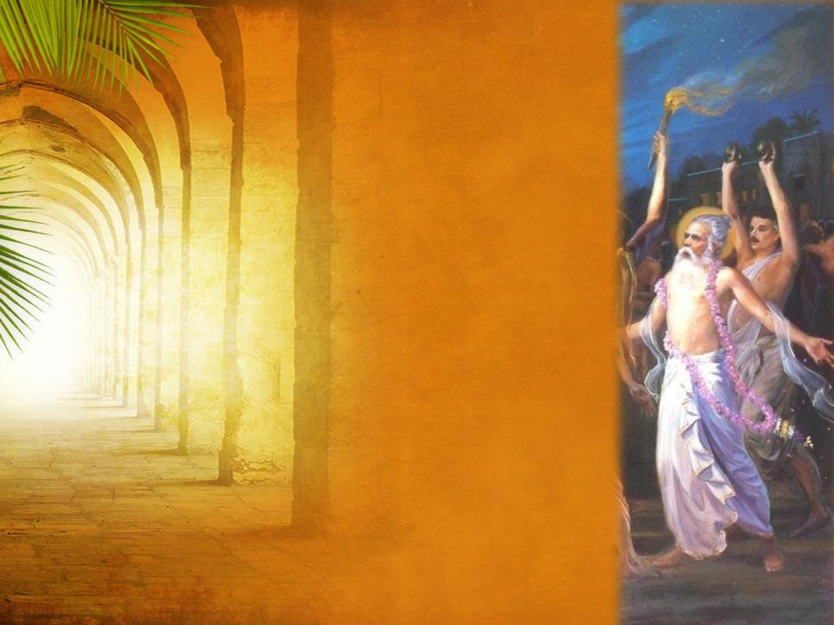
Nuri Nimaanee, Sad Kurbaanee
Nuri Nimaanee, Sad Kurbaanee, Naachat Gaavat Tera Naam
Oothat Baithat Sovat Naam, Aur Na Ko-ee Ko-ee Kaam
Naachat Gaavat Tera Naam, Naachat Gaavat Tera Naam
Ram Lakhan Radhey Shyam, Ram Lakhan Radhey Shyam
* * *

Slide 6
