Slide 1
Jamunaa Jay Jal Dey

Slide 2
Jamunaa Jay!
O! Jamunaa Jay Jala day Nihaaray Nihaaray
Ik Ik Gopi Kanhaiyaa Pukaaray!
Jamunaa jay, O, Jamunaa Jay Dal Day Nihaaray Nihaaray!

Slide 3
Jamunaa Kinaaray Akhiyoon Aab Vahaayin
Mohan Mithay Binn Na Byo Kuchh Chaahin

Slide 4
Chand Khay, Taaran khay, Diyan Say Taaroon
Aao Toon Asaan Vata, Sureen Pukaaroon!
Jamunaa Jay!
O! Jamunaa Jay Jala day Nihaaray Nihaaray

Slide 5
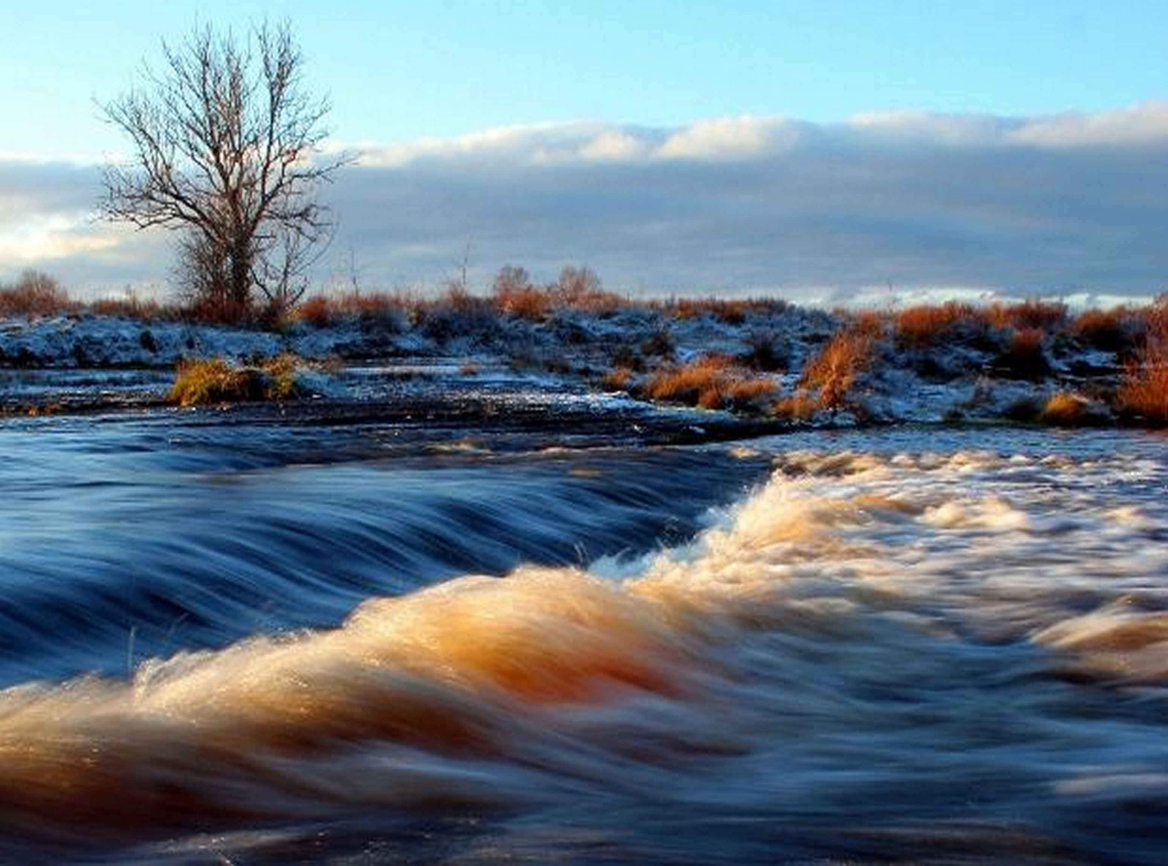
Jamunaa Nadee-a Joon Lehroon Lataaray
Paray Khaan, Paray Khaan, Pyo Kanhaiyo Nihaaray,

Slide 6
Mukh Mein Murlee, Akhyun Mein Israar
Achay Pyo, Achay Pyo, Ishq Jo Avtaar
Jamunaa Jay!
O! Jamunaa Jay Jala Day Nihaaray Nihaaray

Slide 7
Neeleea Bedee-a Mein, Ijho Achay Pyo
Ik Ik Gopee-a Jo, Nern Nachay Pyo
Lehrun Manjhaan, Chhoray Pyo Teer
Dil Andar Uthaaray Ukeer

Slide 8
Jamunaa Jay!
O! Jamunaa Jay Jal-a Day Nihaaray Nihaaray

Slide 9
Shyam Pyaaro Pyo, Murlee Bajaa-ay
Ik Krishna Manjhaan, Pyo Hazaar Banaa-ay
Jamunaa Kinaaray, Ajab Heeya Raas
Ik Ik Gopee-a Saan, Khelay Khaas
Jamunaa Jay!
Ho! Jamunaa Jay Jala Day Nihaaray Nihaaray

Slide 10
Rimjhim, Rimjhim, Gopiyoon Jhooleen Thiyoon
Shyam Agyaan Say, Dilriyoon Kholeen Thiyoon
Pyaasee Diliyun Khay, Pyo Pyaar Peeyaaray
Anjali Unyaayal, Peyee Toh Panaaray

Slide 11
Jamunaa Jay!
O! Jamunaa Jay Jala Day Nihaaray Nihaaray
****

